Slide 1
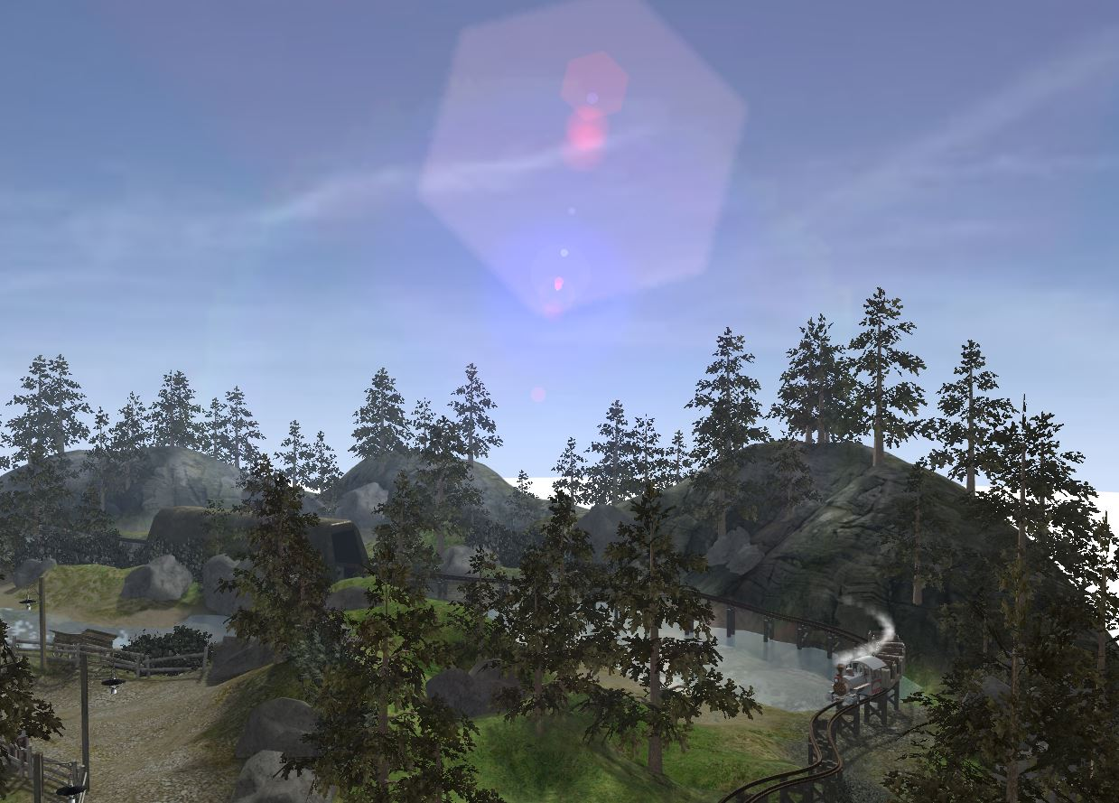
BABYLON.JS
Unleash the power of 3D for the WEB

Slide 2

DAVIDCATUHE
Principal Program Manager
IE / Open Web Standards Developer Experience and Evangelism
davca@microsoft.com - @deltakosh - http://aka.ms/davca

Slide 3

BABYLON.JS…
An average of 1 version per month 32 contributors 34 releases 716 commits 14400+ lines of code More than 125 files of code More than 330 forks A bandwidth of 1 TB per month for the website 1.3GB (Code and samples)

Slide 4
HOW TO USE BABYLON.JS?
Open source project (Available on Github)
http://www.babylonjs.com
https://github.com/babylonjs/babylon.js
How to use it? Include one file and you’re ready to go!
To start Babylon.js, you’ve just need to create an engine object:
<script src="babylon.js"></script>
var engine = new BABYLON.Engine(canvas, true);

Slide 5
HOW TO USE BABYLON.JS?
Babylon.js is a scene graph: All complex features are abstracted for YOU!
Handling rendering can be done in one line:
var scene = new BABYLON.Scene(engine);
var camera = new BABYLON.FreeCamera("Camera", new BABYLON.Vector3(0, 0, -10), scene);
var light0 = new BABYLON.PointLight("Omni0", new BABYLON.Vector3(0, 100, 100), scene);
var sphere = BABYLON.Mesh.createSphere("Sphere", 16, 3, scene);
engine.runRenderLoop(function() { scene.render(); });

Slide 6
DID YOU SAY FEATURES?
Complete scene graph with lights, cameras, materials and meshes
Collisions engine
Physics engine (thanks to cannon.js)
Scene picking
Antialiasing
Animations engine
Particles Systems
Sprites and 2D layers
Frustum clipping
Sub-meshes clipping
Hardware scaling
Selection octrees
Offline mode (Assets are saved locally to prevent reloading them)
Incremental loading
Binary format
Hardware accelerated instances
Diffuse lightning and texture
Ambient lightning and texture
Specular lightning
Opacity texture
Reflection texture (Spheric, planar, cubic and projection)
Mirror texture
Emissive texture
Specular texture
Bump texture
Up to 4 lights (points, directionals, spots, hemispherics)
Custom materials
Skybox
Vertex color
4 bones per vertex
Fresnel term
Fog
Alpha blending
Alpha testing
Billboarding
Fullscreen mode
Shadow Maps and Variance Shadow Maps
Rendering layers
Post-processes (blur, refraction, black'n'white, fxaa, customs...)
Lens flares
Multi-views
Render target textures
Dynamic textures (canvas)
Video textures
Compressed (DDS) textures
Arc rotate camera
Free camera
Touch camera
Virtual Joysticks camera
Oculus Rift camera
Gamepad camera
Mesh cloning
Dynamic meshes
Height maps
Bones
Constructive solid geometries
Babylon scene file can be converted from .OBJ, .FBX, .MXB
Exporter for Blender
Exporter for Cheetah3d
Exporter for 3ds Max
Support for drag'n'drop
….

Slide 7
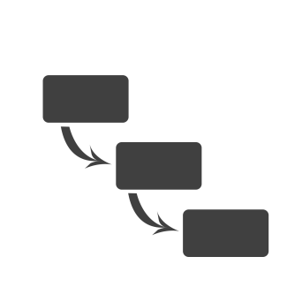
FIRST CONTACT
Hello world Babylon.js
Notes:
Step 0 – step 4

Slide 8
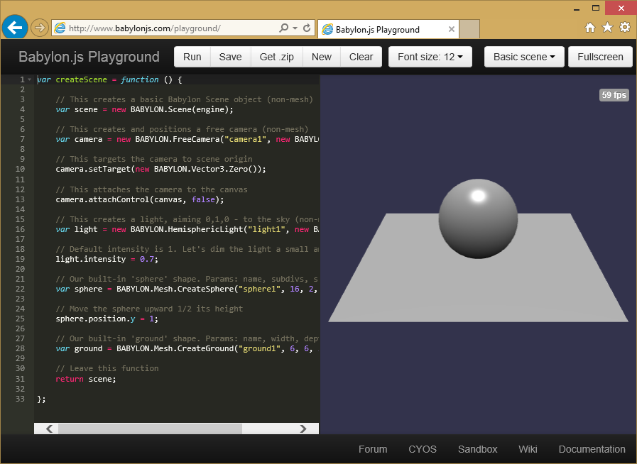
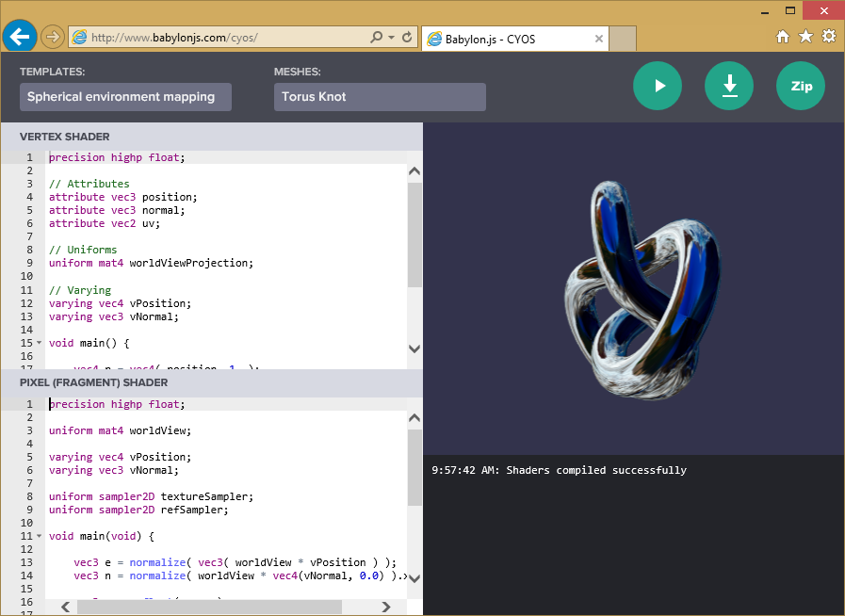
LEARN & EXPERIMENT
Playground
CYOS
Notes:
Select code from Playground and copy/paste to previous page
Step 5

Slide 9
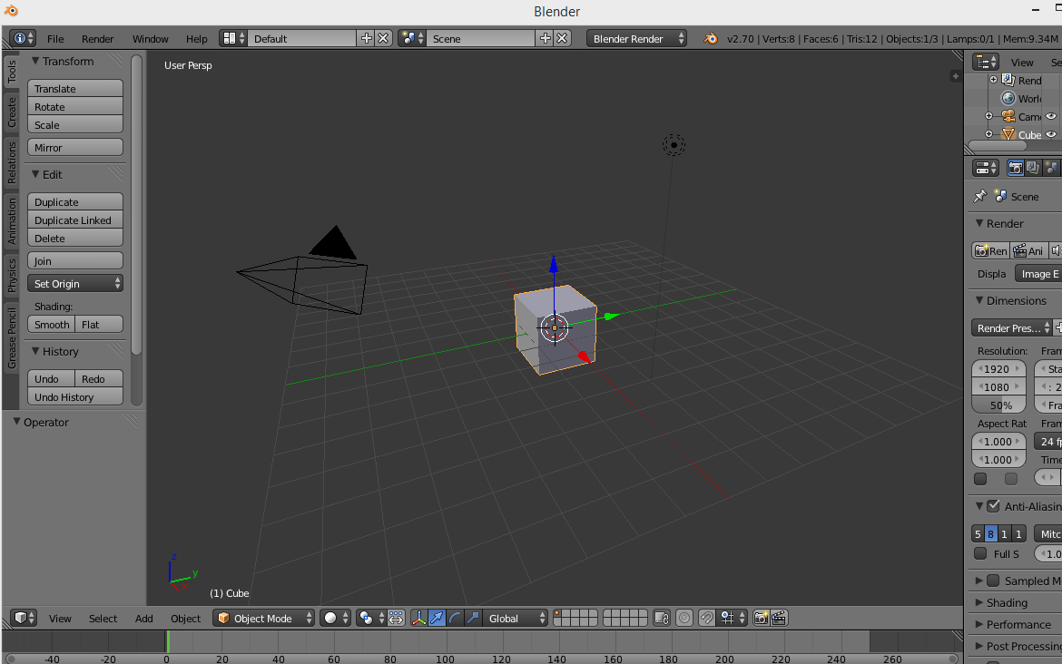
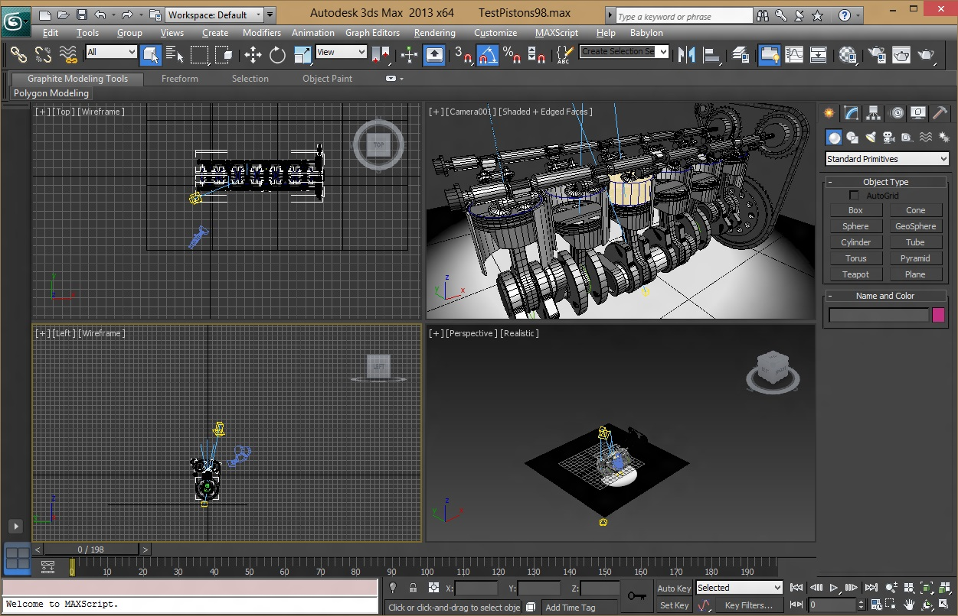
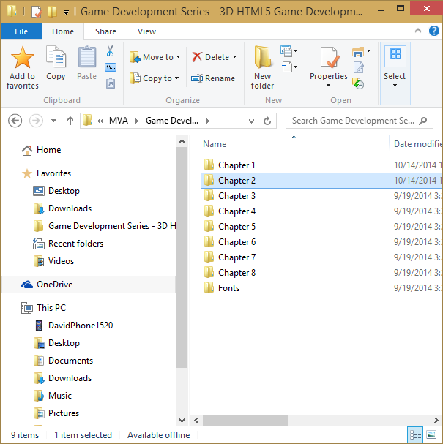
WORKING WITH ASSETS
Blender 3D
3DS Max
.OBJ, .FBX, .DAE
Exporters / Online converter
.BABYLON
Notes:
Export v8 from 3dsmax
Export from Blender

Slide 10
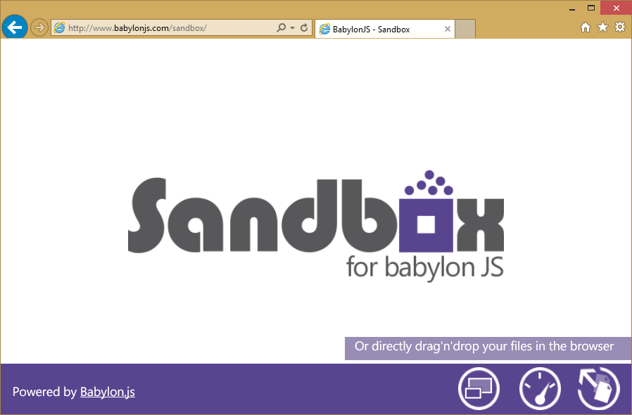
TEST IT LIVE
Notes:
Select code from Playground and copy/paste to previous page

Slide 11
.BABYLON FORMATS
.BABYLON
One scene file
.INCREMENTAL.BABYLON
One scene file
One data file per mesh
JSON format for both
.BINARY.BABYLON
One scene file
JSON format
One data file per mesh
.JSON format for scene
BINARY data for mesh
Data loaded directly to GPU
Espilit demo: 22MB / 4MB (gzip)
Espilit demo: 22MB / 4MB (gzip)
Espilit demo: 9MB / 3MB (gzip)
Notes:
Show difference on file
Sample 6/7

Slide 12






PLAYING WITH INPUT
Touch
Device Orientation
Virtual Joysticks
Anaglyph
VR
Gamepad
Camera based on pointer events
Camera based on Device Orientation API
Using pointer events, this camera generates two joysticks on top of the scene
Use this camera with Red/Green glasses
Control camera orientation with:
Oculus Rift
WebVR
CardBoard
Use your gamepad to control your camera
Notes:
Exemple de cameras
Step 8 – 1
Step 8 - 2

Slide 13
COLLISIONS & PHYSICS
A quick glance to some “out of the box” features
Notes:
Single physics demo
Davrous physics demo
http://www.visualiser.fr/Babylon/Drift/default.htm

Slide 14
UNIVERSAL APP
Creating Windows and Windows Phone apps with Babylon.js
Notes:
Copy/Paste previous code to vs

Slide 15
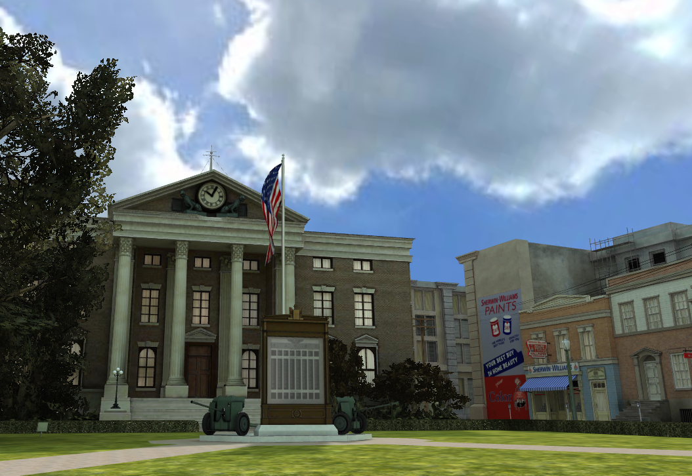
USEFUL LINKS
http://www.babylonjs.com
http://www.babylonjs.com/playground
http://www.babylonjs.com/cyos
https://github.com/BabylonJS/Babylon.js/wiki
http://www.html5gamedevs.com/forum/16-babylonjs

Slide 16
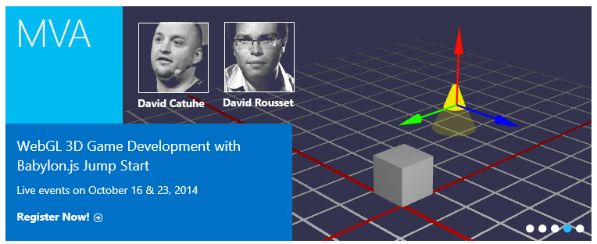
01 | 3D on the Web: Understanding the Basics | 02 | WebGL Basics
03 | Using Babylon.js for Beginners | 04 | Understanding materials and inputs
05 | Game Pipeline Integration with Babylon.js | 06 | Loading Assets
07 | Babylon.js: Advanced Features | 08 | Special Effects

Slide 17
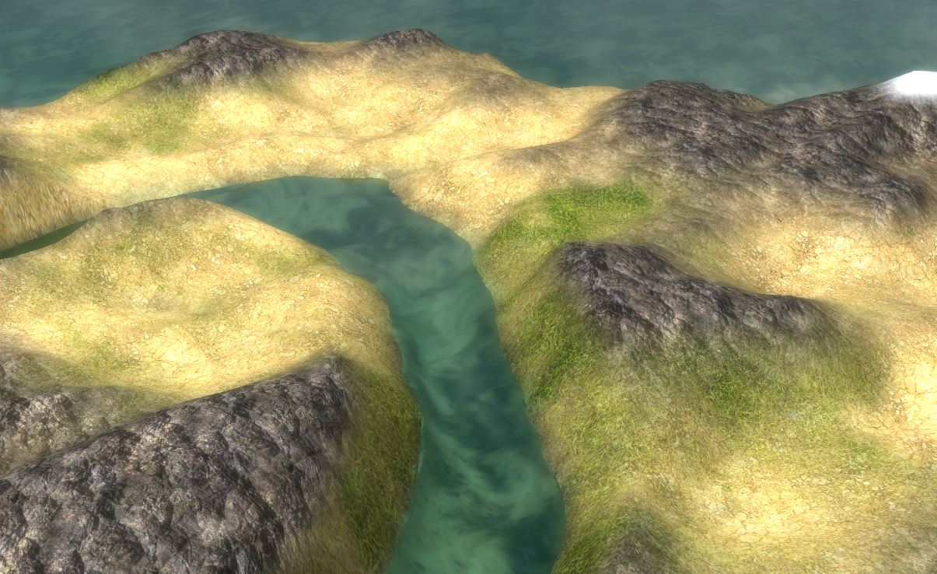
THANK YOU!

